Slide 1
MUSA 509 Final Project
Tract-level Infrastructure Overview
in New York City
Haobing Liu ｜ April 29, 2023

Slide 2
- related to capstone project
- Identify dataset
- Python script to ELT
- Visualization using Dash
- Deploy Dash app into Heroku
python script

Slide 3
58,925
59,904
1,432
32,437
473
680
streetlight conditions
pavement ratings
vacant and unsecure buildings
facilities
subway stations
women's resource network
census data
identify data

Slide 4
warehouse
specifically, in Google BigQuery
store large scale data
do querying

Slide 5
extract - load - transform

Slide 6
visualize
with Dash
choropleth map (census tract)
distribution histogram
select the feature

Slide 7
deploy to heroku
cloud platform
deploying, managing, scaling apps
push code to the remote repository

Slide 8
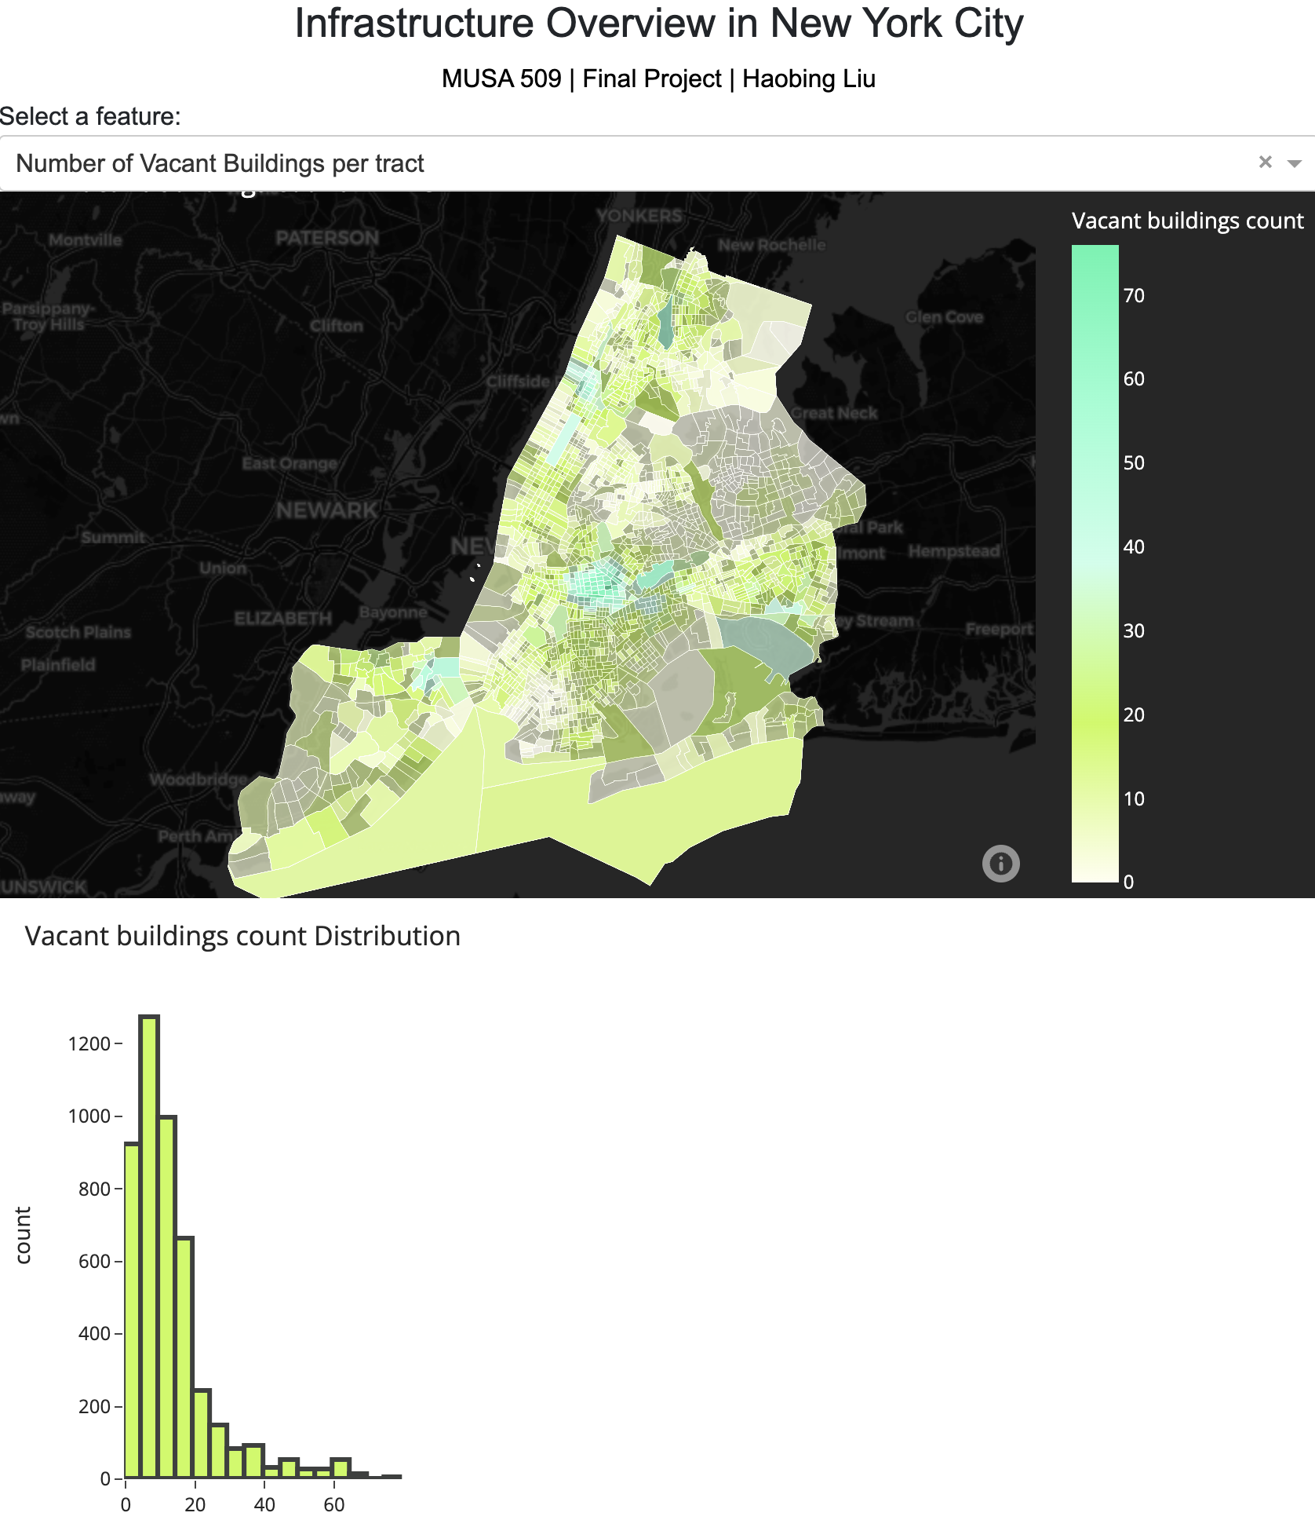
MUSA 509 Final Project
thanks!

